Slide 1








LOGO
“Humans vs Machines: Is AI Taking Over?”
Exploring the ethical dimensions of artificial intelligence: Balancing innovation and responsibility in the age of intelligent machines.
Presented by:
Esra
Ewakise
Theophilus

Slide 2
Project Overview – Topic and Dataset
Topic Chosen: “Humans vs Machines: Is AI Taking Over?”
Why This Topic? Growing relevance in the digital era;
widespread debate around the effect on employment
Original Dataset Sources:
Labor statistics (e.g., BLS, Eurostat)
AI industry reports
Social media sentiment (Twitter, Reddit)

Slide 3
Project Overview – Hypotheses & Process
Hypotheses Tested: H1: Automation risk correlates with higher unemployment H2: AI-adopting industries show productivity gains but shrinking workforce growth H3: Public sentiment on AI is increasingly negative H4: Creative roles are less automatable
Process: Data collection → Cleaning → Enrichment → EDA → Hypothesis Testing

Slide 4


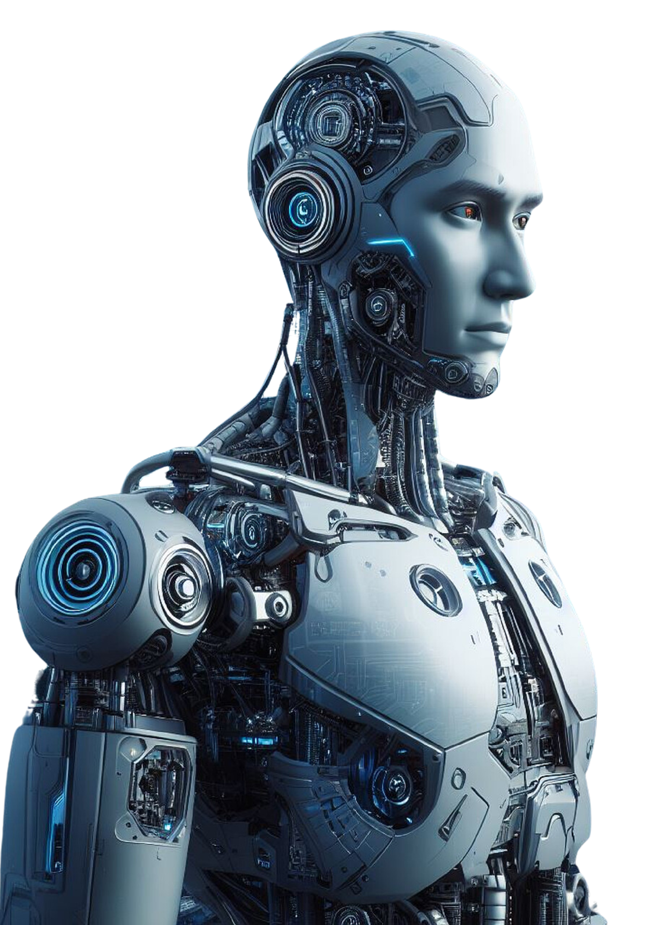



LOGO
Data Wrangling & Cleaning – Challenges
Challenges:
Missing job growth data
Inconsistent date formats
Duplicates in social media datasets
Sentiment analysis needed preprocessing
Techniques Used: Regex, string normalization, column merging

Slide 5
LOGO
Data Wrangling & Cleaning – Enrichment
APIs Used:
Twitter API for sentiment data
Hugging Face NLP models for sentiment classification
Web Scraping:
Job automation risk indices from academic sites
Outcome: Created a rich dataset combining numerical trends with qualitative sentiment

Slide 6







LOGO
T
Exploratory Data Analysis – Methods
EDA Tools:
Techniques
Goal
Pandas, Matplotlib, Seaborn.
Correlation analysis, time series visualization, sentiment distribution plots
Detect patterns and validate hypotheses visually before statistical testing
.

Slide 7
LOGO
Exploratory Data Analysis – Insights
High automation-risk jobs (e.g., data entry, manufacturing) show negative growth
Finance and tech industries: productivity up, workforce plateaued
Sentiment analysis: spike in negative sentiment since late 2022
Creative fields: lower automation scores, but mixed public sentiment

Slide 8
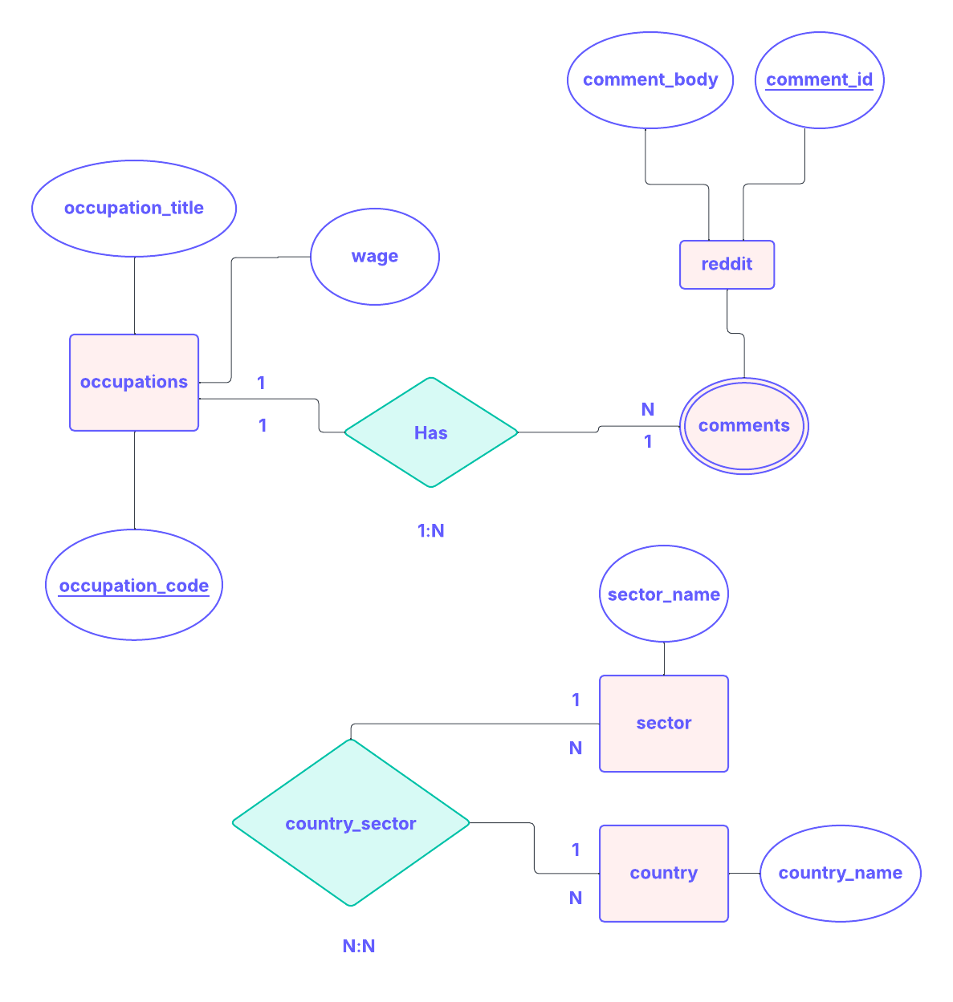
LOGO
Visualizations

Slide 9
LOGO
Visualizations

Slide 10


LOGO
HOME
ABOUT
SERVICE
CONTACT
Major Obstacle
Biggest Challenge
Mistake:
Cleaning and classifying public sentiment data
Initially used a simple word-count method → results were skewed
Lesson Learned
Would Do Differently
Importance of using pre-trained sentiment models
Integrate advanced NLP from the start

Slide 11

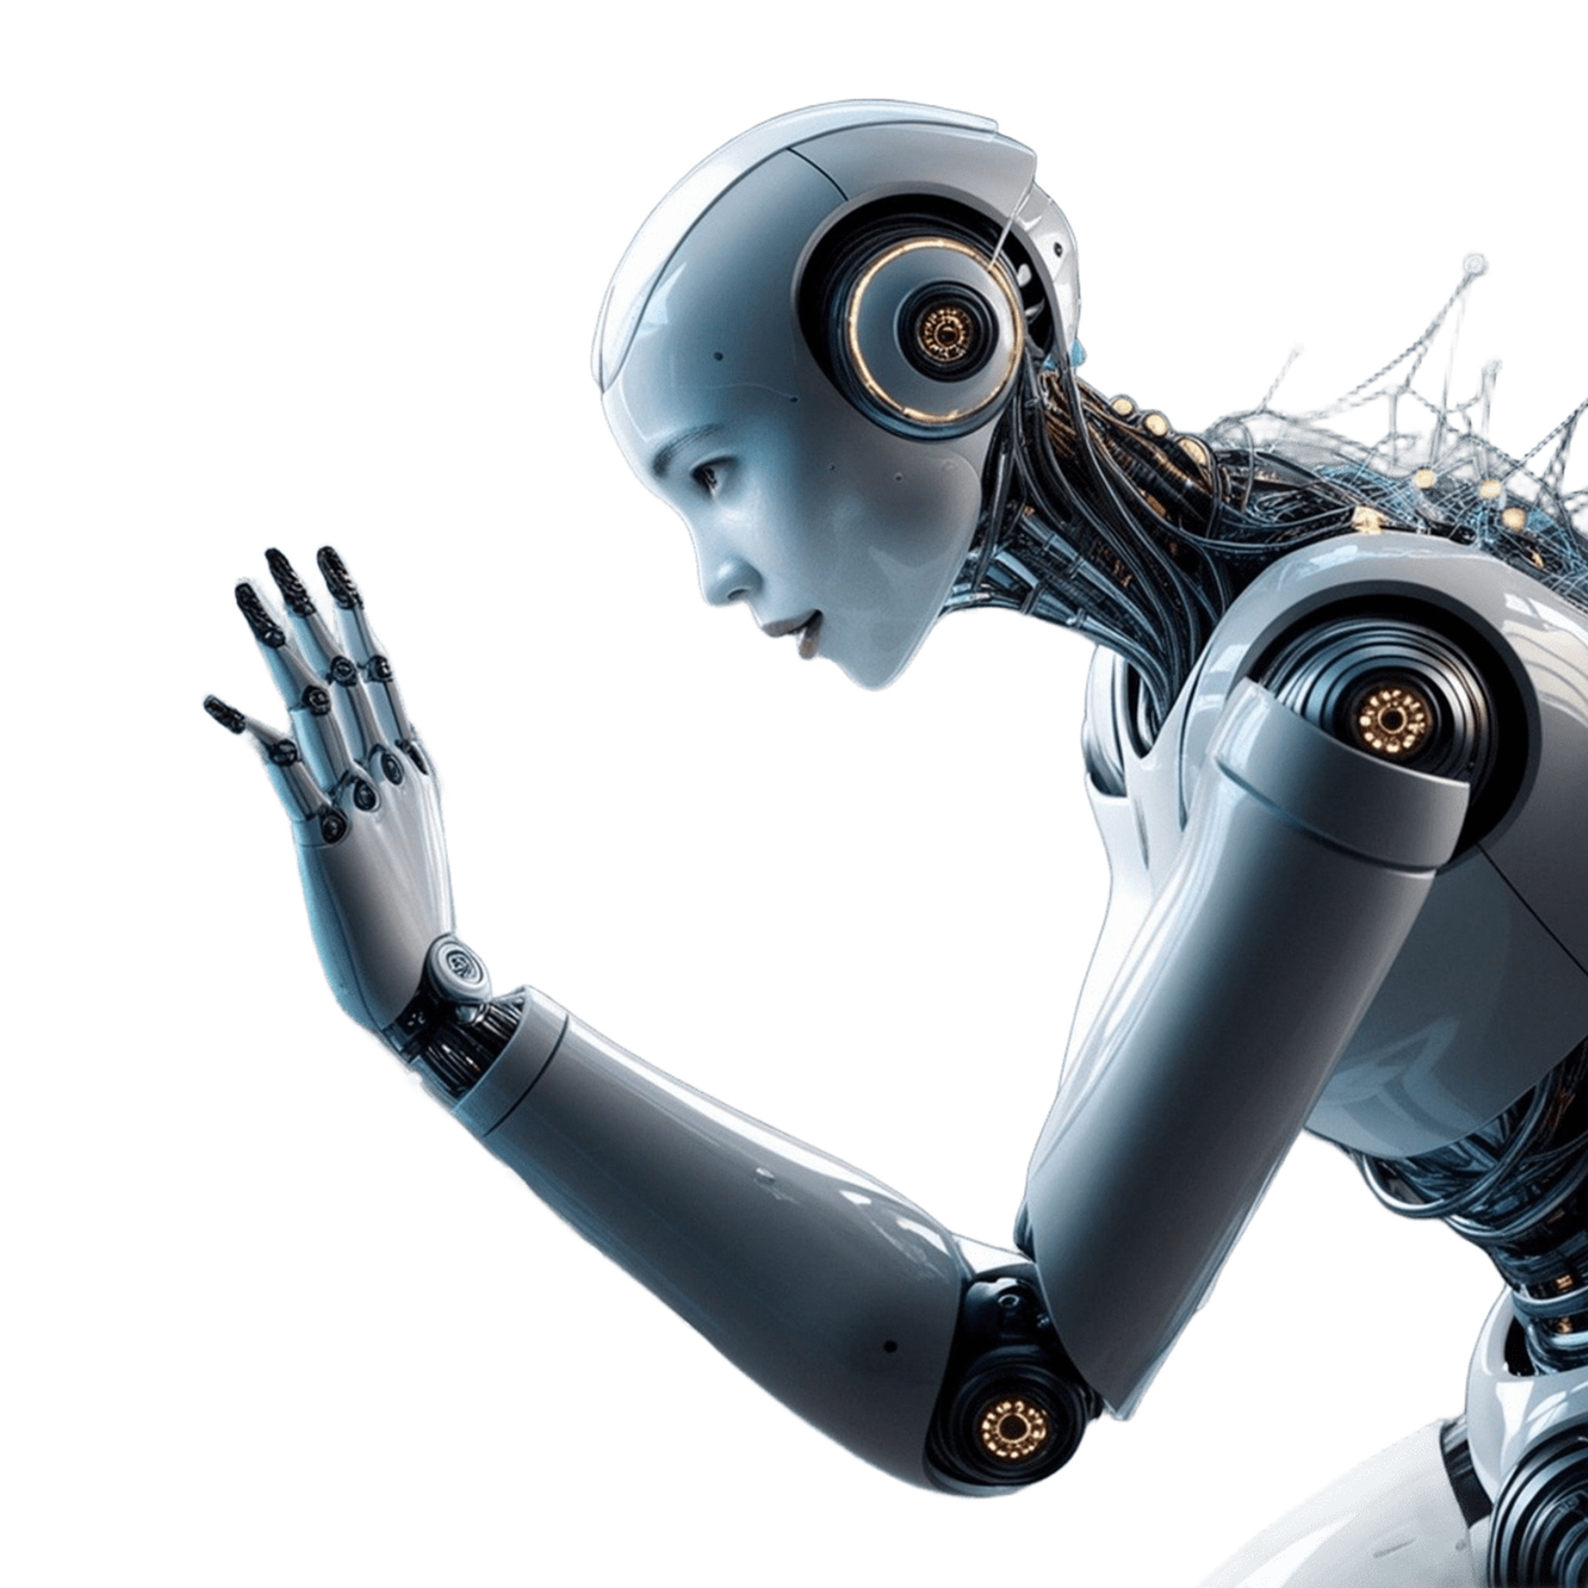


LOGO
Conclusion – Hypotheses & Learnings
Supported: H1, H2, H3
Partially Supported: H4 – creative fields less automatable but still impacted
Learnings:
AI impacts are industry-specific
Public perception is rapidly shifting
Data enrichment adds powerful context to quantitative trends

Slide 12
LOGO
HOME
ABOUT
SERVICE
CONTACT
Implications & Unanswered Questions
Implications:
Policymakers need to prepare for reskilling needs
AI will reshape—not eliminate—many jobs
Unanswered:
How fast will new jobs emerge to replace lost ones?
Are creative jobs truly future-proof or just slower to automate?

Slide 13






LOGO
HOME
ABOUT
SERVICE
CONTACT
KEY ETHICAL ISSUES IN AI
ACCOUNTABILITY AND RESPONSIBILITY
BIAS AND FAIRNESS
Explore how AI systems can perpetuate or even amplify existing biases.
Who is accountable when AI systems cause harm?
PRIVACY AND SURVEILLANCE
TRANSPARENCY AND EXPLAINABILITY
Discuss the ethical implications of AI in data collection and surveillance.
The importance of making AI decisions understandable and transparent to users.

Slide 14


LOGO
HOME
ABOUT
SERVICE
CONTACT
Project Overview – Topic and Dataset
1.
02.
03.
INTRODUCTION
OUR PROJECTS
ABOUT US
Elaborate on what you want to discuss.
Elaborate on what you want to discuss.
Elaborate on what you want to discuss.

Slide 15
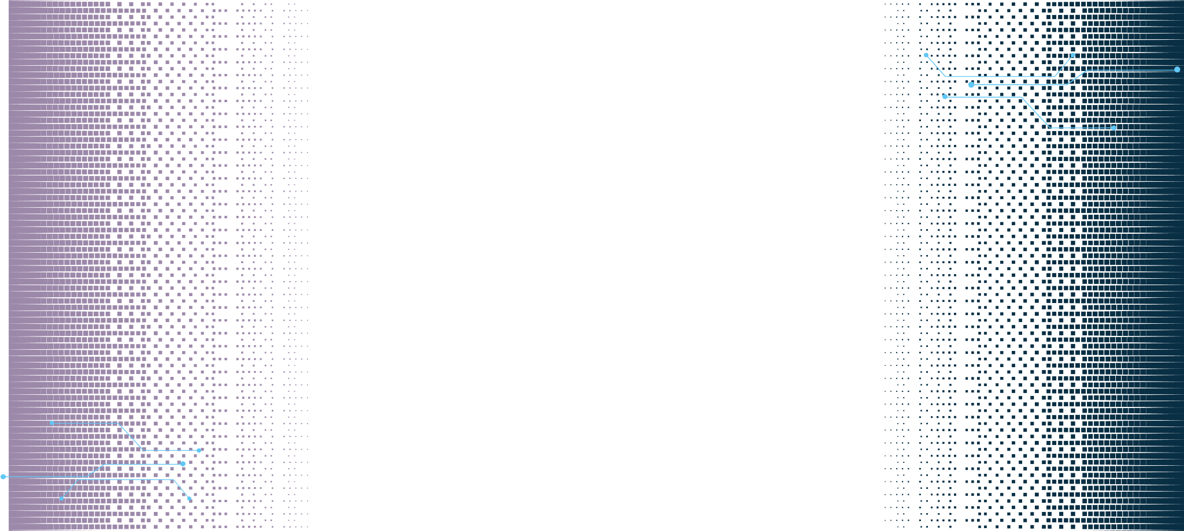







LOGO
HOME
ABOUT
SERVICE
CONTACT
DEONTOLOGICAL ETHICS
Applying duty-based ethics to AI: adherence to rules and principles.
ETHICAL FRAMEWORKS AND APPROACHES
UTILITARIAN ETHICS
Evaluating AI based on outcomes: maximizing benefits and minimizing harm.
VIRTUE ETHICS
Focusing on the moral character of those who create and use AI systems.

Slide 16
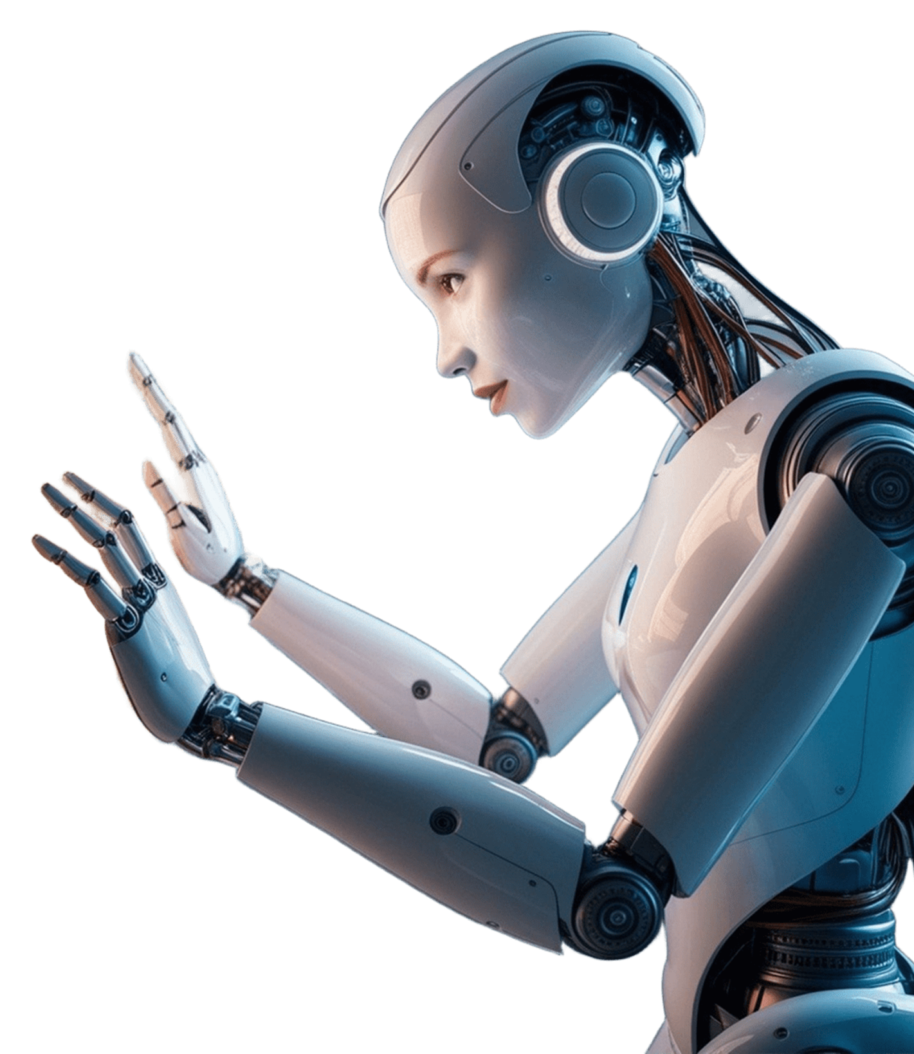



LOGO
HOME
ABOUT
SERVICE
CONTACT
FUTURE DIRECTIONS IN AI ETHICS
AI AND HUMAN RIGHTS
How AI might challenge or support fundamental human rights.
AI IN GLOBAL GOVERNANCE
The role of international cooperation in establishing AI ethics standards.

Slide 17

LOGO
HOME
ABOUT
SERVICE
CONTACT
CASE STUDIES
CASE STUDY 1:
AI IN HEALTHCARE
CASE STUDY 2:
AI IN AUTONOMOUS VEHICLES
The integration of Artificial Intelligence (AI) into healthcare has brought about a transformative shift in how medical diagnosis, treatment, and patient care are approached. However, while AI offers numerous benefits, its use in these critical areas also raises significant ethical concerns that must be carefully considered to ensure that technology serves the best interests of all patients.
Autonomous vehicles (AVs) represent a groundbreaking innovation in transportation, promising to reduce traffic accidents, improve road safety, and revolutionize mobility. However, the deployment of AVs also introduces profound ethical dilemmas, particularly in scenarios where the vehicle must make decisions involving life-and-death situations. Unlike human drivers.

Slide 18

LOGO
HOME
ABOUT
SERVICE
CONTACT
Project Overview – Topic and Dataset
I'm Rain, and I'll be sharing with you my beautiful ideas. Follow me at @reallygreatsite to learn more.

Slide 19





LOGO
HOME
ABOUT
SERVICE
CONTACT
TESTIMONIALS
CLIENT NAME
CLIENT NAME
CLIENT NAME
Elaborate on what you want to discuss.
Elaborate on what you want to discuss.
Elaborate on what you want to discuss.

Slide 20
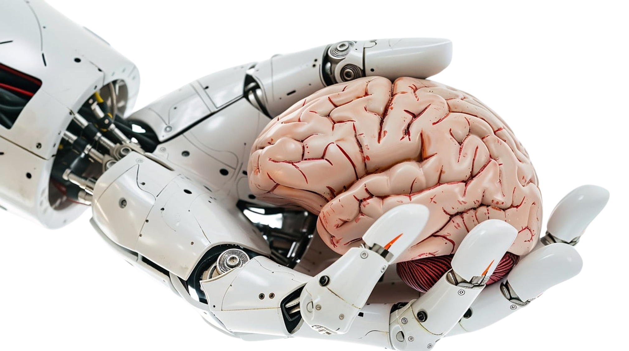

LOGO
HOME
ABOUT
SERVICE
CONTACT
ABOUT US
We are a team of passionate individuals dedicated to providing exceptional service and creating memorable experiences for our clients. With a commitment to excellence and a focus on innovation, we strive to exceed expectations and deliver top-notch results. Our goal is to build lasting relationships with our clients and make a positive impact in everything we do. Thank you for choosing us to be a part of your journey.

Slide 21
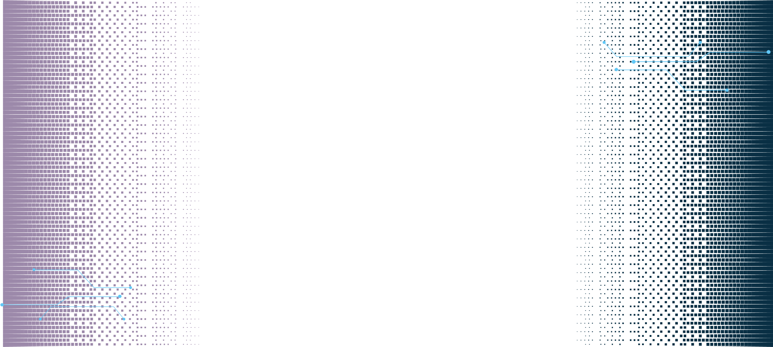







LOGO
HOME
ABOUT
SERVICE
CONTACT
TRANSPARENCY
Elaborate on what you want to discuss.
RESPECT FOR HUMAN VALUES
PRIVACY
Elaborate on what you want to discuss.
Elaborate on what you want to discuss.
ETHICS IN AI
ACCOUNTABILITY
FAIRNESS
Elaborate on what you want to discuss.
Elaborate on what you want to discuss.
SAFETY
Elaborate on what you want to discuss.

Slide 22




LOGO
HOME
ABOUT
SERVICE
CONTACT
OUR HISTORY
ADD A MAIN POINT
ADD A MAIN POINT
ADD A MAIN POINT
Elaborate on what you want to discuss.
Elaborate on what you want to discuss.
Elaborate on what you want to discuss.

Slide 23

A PICTURE IS WORTH A THOUSAND WORDS

Slide 24


LOGO
HOME
ABOUT
SERVICE
CONTACT
WRITE AN ORIGINAL STATEMENT OR INSPIRING QUOTE
— Include a credit, citation, or supporting message

Slide 25
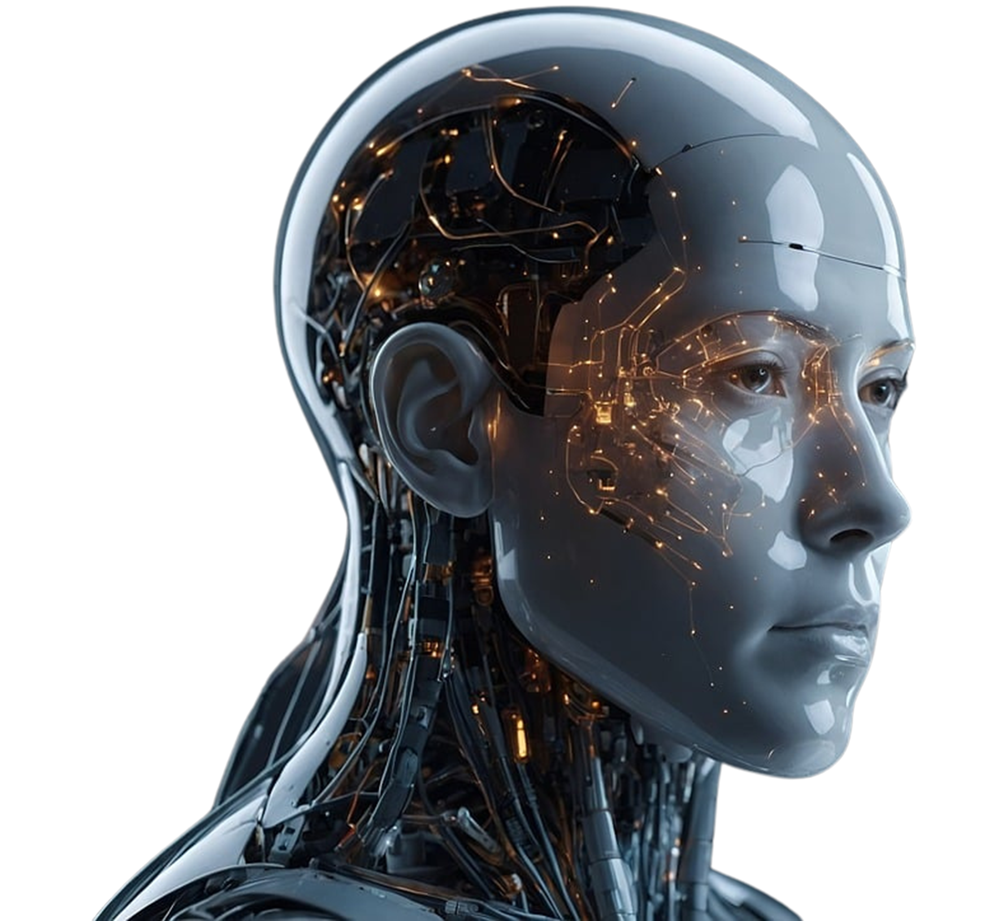




LOGO
HOME
ABOUT
SERVICE
CONTACT
CONTACT US
123 Anywhere St., Any City,ST 12345
123-456-7890
hello@reallygreatsite.com
@reallygreatsite
reallygreatsite.com

Slide 26

RESOURCE
PAGE
Use these design resources in your Canva Presentation.
You can find these fonts online too. Happy designing!
Don't forget to delete this page before presenting.
This presentation template uses the following free fonts:
Titles: Oswald
Headers: Oswald
Body Copy: Montserrat

Slide 27
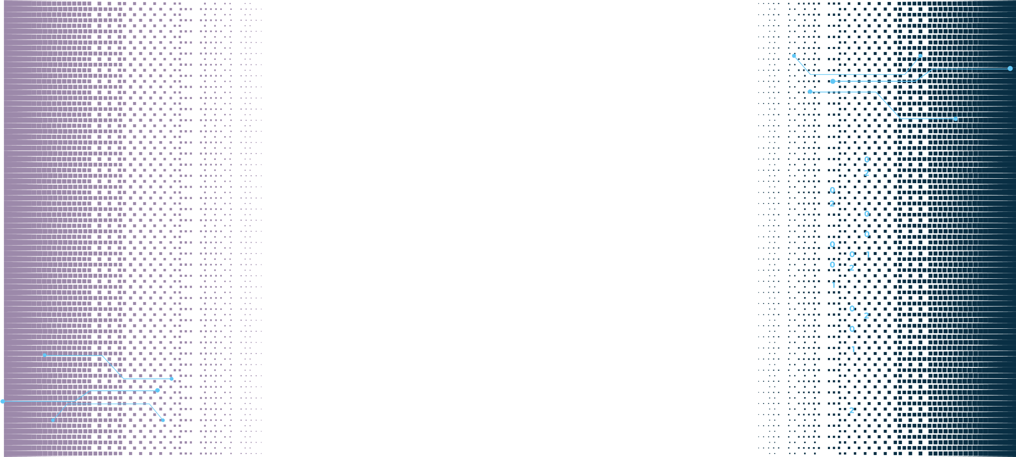

CREDITS
This presentation template is free for everyone to use thanks to the following:
SlidesCarnival for the presentation template
Pexels for the photos
Happy designing!

